Slide 1
React Redux
Redux essentials
Redux and React in practice

Slide 2
1. Redux Essentials
Overview of Redux
Identifying state
Defining actions
Defining reducers
Creating a Redux store
Dispatching actions to a Redux store
Subscribing to store changes
Defining action creators
Aside: Composing functions

Slide 3
Overview of Redux
Redux helps you manage state in an application
Redux has a store
Holds all the state for your application
The state is immutable (can't change, can be replaced)
Redux has action objects
Specify a change you want to make to the state
Redux has reducer functions
Receives current state and action, returns updated state
3

Slide 4
Identifying State
When you build a Redux app, the first thing you should do is to think about state
What data will your app be manipulating and displaying?
A good approach is to try to write down a JSON object that contains all the state in a single object
Remember, Redux stores all the state in a single object
Let's think about state for a product management app
See identifyingState.json
4

Slide 5
Defining Actions
The next step is to think about what actions can happen in the system, which cause state to be updated
i.e. what do you want the application to actually do?
Our product management app needs these actions:
Add/remove/like a product
Specify the sort order for products
Think what data you need to perform each action
See actions.html
5

Slide 6
Defining Reducers
Actions are "carried out" by reducer functions
In our system, we define 3 reducer functions:
See reducers1_product.html
See reducers2_products.html
See reducers3_sort.html
Each reducer function:
Receives some state (e.g. product), plus an action param
Returns new state (e.g. updated product)
6

Slide 7
Creating a Redux Store
The next step is to create the Redux store
You do this via Redux.createStore(…)
Pass 2 parameters:
A combination of the top-level reducers in your app
The initial state for the Redux store (e.g. via a REST call)
Example:
See store1_createStore.html
7

Slide 8
Dispatching Actions to the Redux Store
When something happens in your app, dispatch an action to the Redux store to update the app's state:
Create an action object with info about what's happened
Call dispatch() on Redux store, pass action as param
Redux receives the action and sends it to the appropriate reducer function to effect the change
Example:
See store2_dispatchingActions.html
8

Slide 9
Subscribing to Store Changes
You can subscribe to state-changes in the Redux store
You specify a call-back function, which Redux will call whenever any state in the store changes
Why is this useful?
Logging
Forcing the application to re-render itself (see later)
Example:
See store3_subscribingStoreChanges.html
9

Slide 10
Defining Action Creators
When you start implementing your React code, you'll create action objects to trigger state updates
E.g. when the user clicks the "Add Product" button, you'll create an "Add Product" action object
It’s important you create these action objects correctly
To achieve consistency, define action creator functions, which return a correctly structured action object
Example:
See actionCreators.html
10

Slide 11
Aside: Composing Functions
This is an optional (but nice) technique…
You can compose several functions together into a single function via Redux.compose()
This can help you perform a task comprising many steps
Example:
See composingFunctions.html
11

Slide 12
2. Redux+React in Practice
Recap of Redux Store concepts
Using Redux in a full application
Example application
Dependencies for React Redux
Ex 1 - Adding state to the store
Ex 2 - Dispatching actions
Ex 3 - "Add product" form
Ex 4 - Accessing the store via context
Ex 5 - React Redux provider

Slide 13
Recap of Redux Store Concepts
Here's a recap of what we've seen so far with Redux...
Actions (objects that describe a desired change)
Reducers (functions that return new state)
Creating a Redux Store
Dispatching actions to Redux Store, e.g. due to UI events
Subscribing to Redux Store changes
13

Slide 14
Using Redux in a Full Application
We're now going to see how to use Redux in a full React application
How to organize your code
How to handle UI events, to dispatch actions to Redux
How to update the UI when reducers return new state
How to use TypeScript effectively
We'll also introduce the React Redux library
Connects a Redux Store to your React components
14

Slide 15
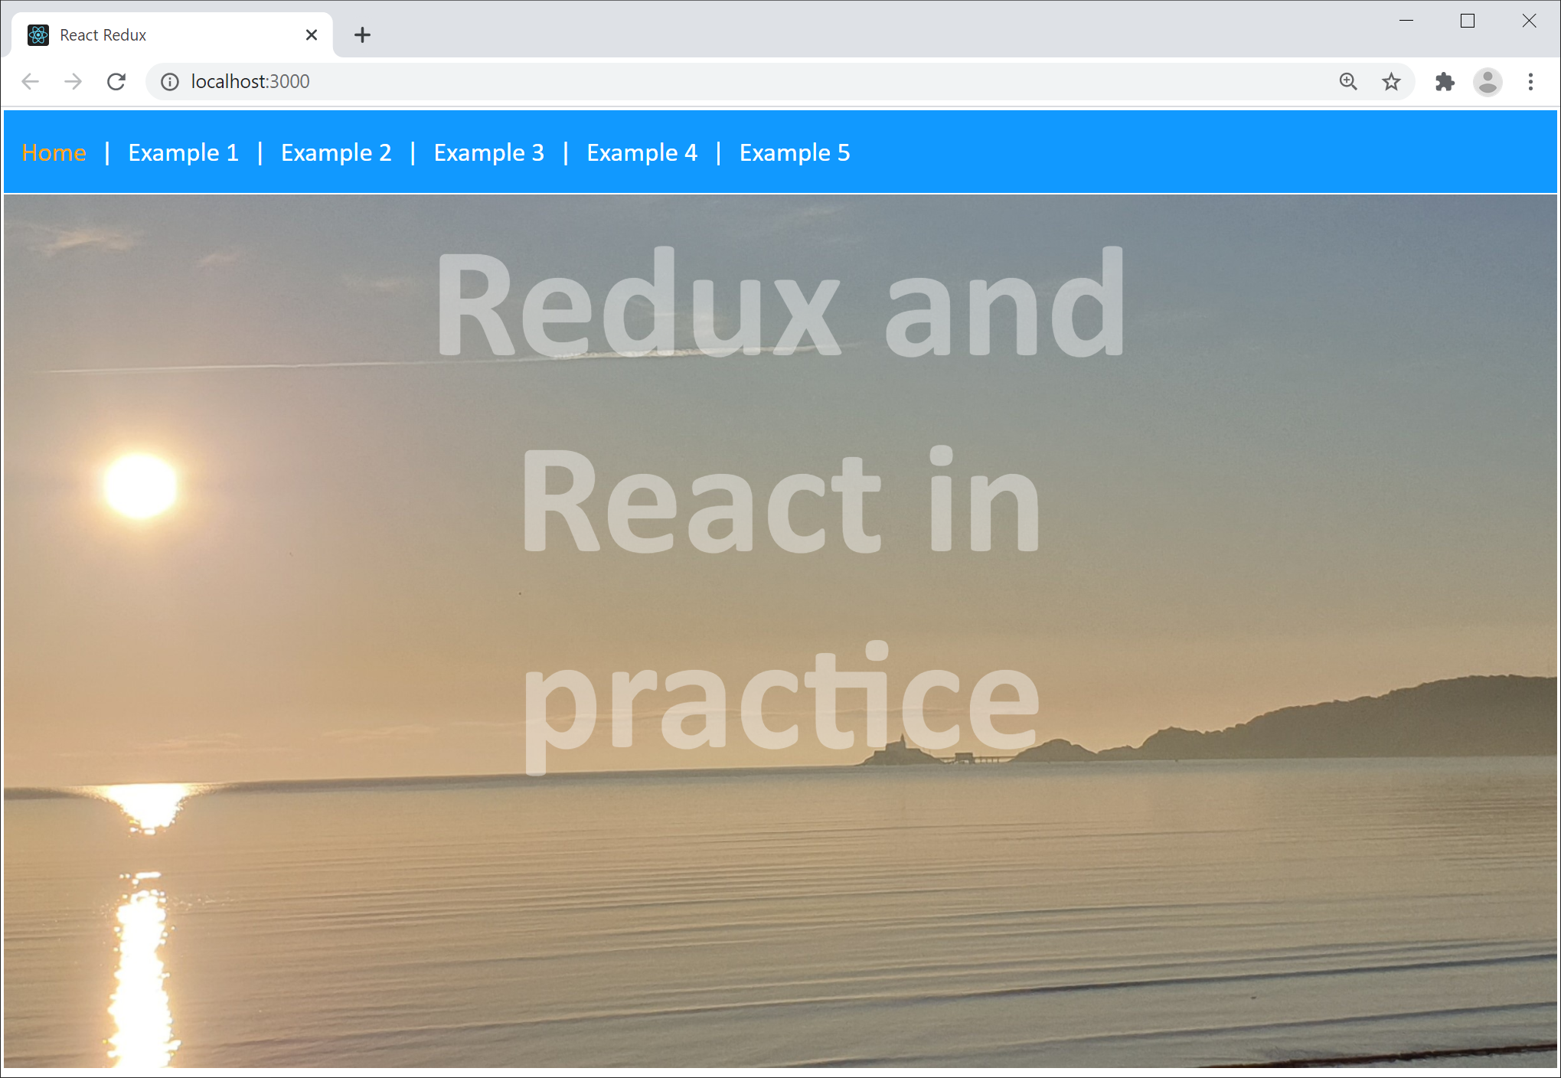
Example Application
Go to the demo-app folder and run
There are 5 examples
Incremental complexity
npm start
15

Slide 16
Dependencies for React Redux
To use React Redux, add the following dependencies in your package.json file
You can make these changes as follows:
{
"dependencies": {
"react-redux": "^7.2.4",
"@types/react-redux": "^7.1.18",
…
},
…
}
React Redux
React Redux TypeScript declarations
package.json
npm install --save react-redux [for TypeScript or JavaScript]
npm install --save @types/react-redux [for TypeScript only]
16

Slide 17
Example 1: Adding State to the Store
Defines initial state
See data/initialState.json
Defines actions and reducers, similar to prev section
See src/types and src/code
Creates and uses dedicated Redux Store
Redux Store creation: src/components/Main.tsx
Redux Store usage: src/components/*
17

Slide 18
Example 2: Dispatching Actions
Users can now "like" or "remove" a product
See the ProductList component:
Passes onLike/onRemove functions into a product, which dispatch appropriate actions to the Redux store
Now see the Product component:
Renders "Like" and "Product" buttons
When clicked, invoke the onLike/onRemove functions
Also see the Main component, forces React to render
18

Slide 19
Example 3: "Add Product" Form
Users can now add a new product
See src/components/AddProductForm.tsx
The AddProductForm component:
Defines a UI form, for the user to enter product details
When the user clicks "Add Product", it dispatches an appropriate action to the Redux store
Also see the Main component
Renders an AddProductForm
19

Slide 20
Example 4: Accessing Store via Context
All the examples so far have passed the Redux store down to all components that need it
So components can access state and dispatch actions
Passing the Redux store down a component chain is error-prone for deep component hierarchies
Alternative approach:
Main component puts Redux store into the "context"
Child components can access Redux store in the context
20

Slide 21
Example 5: React Redux Provider
React Redux is an optional library that makes it easier to connect your components to the Redux store
Makes the Redux Store available to your components
Ensures React re-renders components if Store changes
See detailed comments in the following files:
src/components/Main.tsx
src/components/ProductList.tsx
src/components/AddProductForm.tsx
21

Slide 22
Summary
Redux essentials
Redux and React in practice

